Slide 1

Computer Programming for Engineers
Week 5 Lecture 2
Sep. 29, 2022
Lecturer: Mohammad Mahdi Javidan
College of Engineering, Sungkyunkwan University
Fall Semester 2022

Slide 2
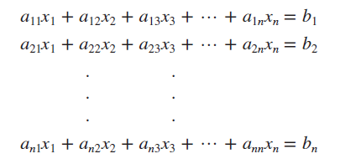
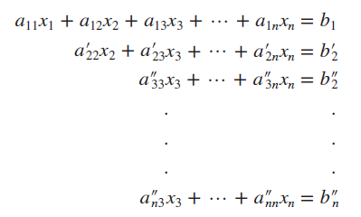

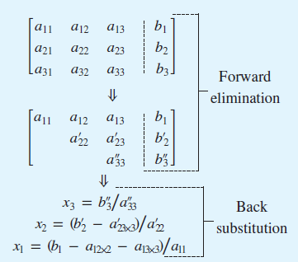

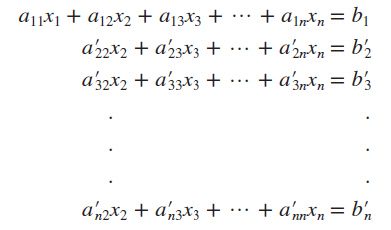
System of Linear Equations
Naïve Gauss Elimination
Pivot equation
Pivot coefficient
Augmented matrix
College of Engineering, Sungkyunkwan University

Slide 3
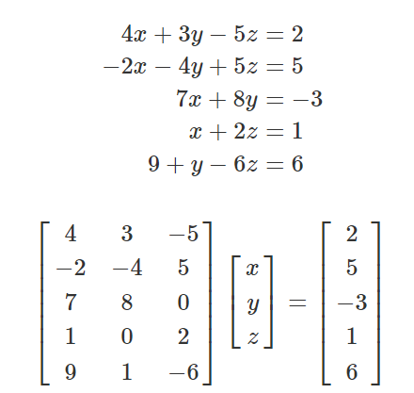
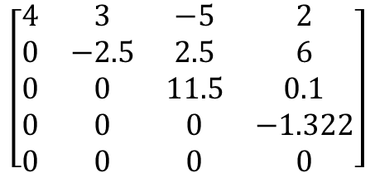
System of Linear Equations
$$\left[\begin{matrix}4 & 3 & −5 & 2 \\ 0 & −2.5 & 2.5 & 6 \\ 0 & 0 & 11.5 & 0.1 \\ 0 & 0 & 0 & −1.322 \\ 0 & 0 & 0 & 0\end{matrix}\right]$$
Gauss elimination
College of Engineering, Sungkyunkwan University

Slide 4
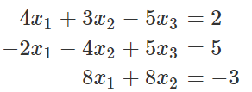
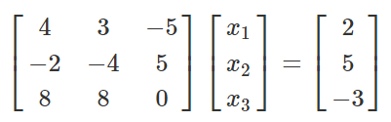
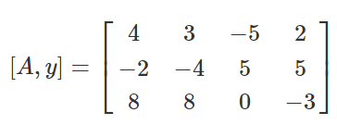
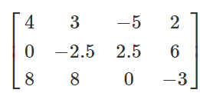
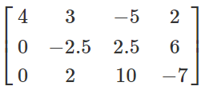
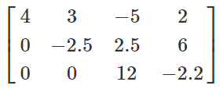

System of Linear Equations
Augmented Matrix
Forward elimination
Backward substitution
College of Engineering, Sungkyunkwan University

Slide 5
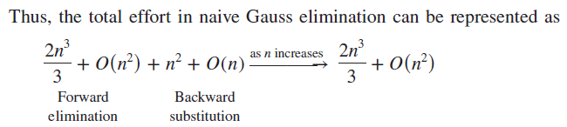
System of Linear Equations
College of Engineering, Sungkyunkwan University

Slide 6

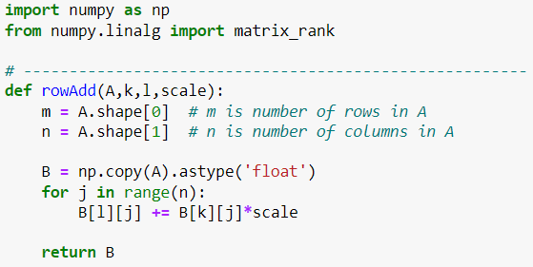
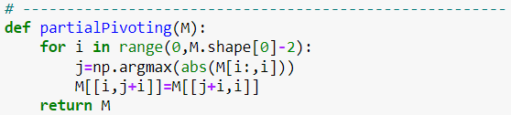
System of Linear Equations
Gauss elimination code
College of Engineering, Sungkyunkwan University

Slide 7
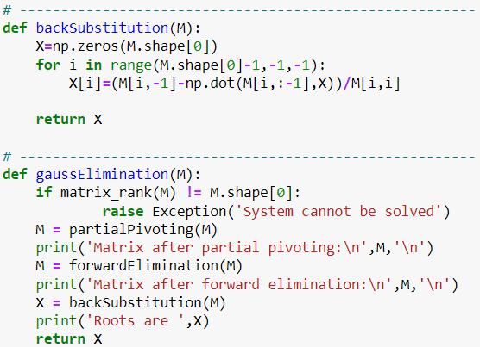
System of Linear Equations
College of Engineering, Sungkyunkwan University

Slide 8

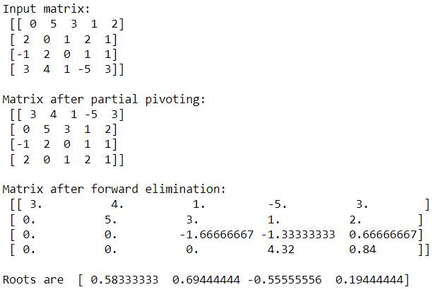
System of Linear Equations
College of Engineering, Sungkyunkwan University

Slide 9




Some Properties of Determinant
also holds for swapping rows
Can be used in conjunction with Gauss elimination
College of Engineering, Sungkyunkwan University

Slide 10
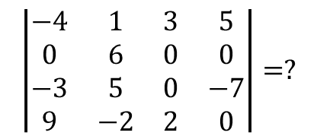
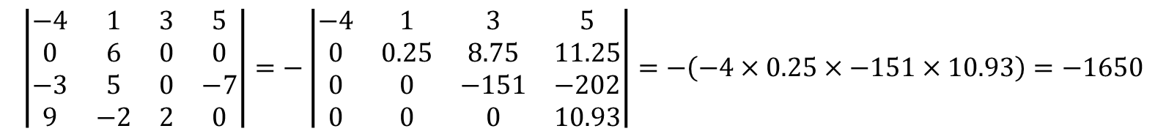
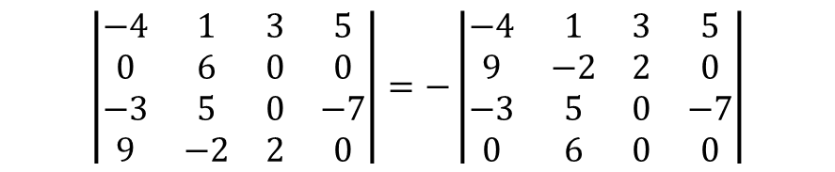
Obtaining Determinant Using Gauss Elimination
$$\left|\begin{matrix}−4 & 1 & 3 & 5 \\ 0 & 6 & 0 & 0 \\ −3 & 5 & 0 & −7 \\ 9 & −2 & 2 & 0\end{matrix}\right|=?$$
Example
$$\left|\begin{matrix}−4 & 1 & 3 & 5 \\ 0 & 6 & 0 & 0 \\ −3 & 5 & 0 & −7 \\ 9 & −2 & 2 & 0\end{matrix}\right|=−\left|\begin{matrix}−4 & 1 & 3 & 5 \\ 9 & −2 & 2 & 0 \\ −3 & 5 & 0 & −7 \\ 0 & 6 & 0 & 0\end{matrix}\right|$$
$\left[\begin{matrix}−4 & 1 & 3 & 5 \\ 9 & −2 & 2 & 0 \\ −3 & 5 & 0 & −7 \\ 0 & 6 & 0 & 0\end{matrix}\right]=\left[\begin{matrix}−4 & 1 & 3 & 5 \\ 0 & 0.25 & 8.75 & 11.25 \\ 0 & 4.25 & −2.25 & −10.75 \\ 0 & 6 & 0 & 0\end{matrix}\right]$ $=\left[\begin{matrix}−4 & 1 & 3 & 5 \\ 0 & 0.25 & 8.75 & 11.25 \\ 0 & 0 & −151 & −202 \\ 0 & 0 & −210 & −270\end{matrix}\right]$= $\left[\begin{matrix}−4 & 1 & 3 & 5 \\ 0 & 0.25 & 8.75 & 11.25 \\ 0 & 0 & −151 & −202 \\ 0 & 0 & 0 & 10.93\end{matrix}\right]$
$$\left|\begin{matrix}−4 & 1 & 3 & 5 \\ 0 & 6 & 0 & 0 \\ −3 & 5 & 0 & −7 \\ 9 & −2 & 2 & 0\end{matrix}\right|=−\left|\begin{matrix}−4 & 1 & 3 & 5 \\ 0 & 0.25 & 8.75 & 11.25 \\ 0 & 0 & −151 & −202 \\ 0 & 0 & 0 & 10.93\end{matrix}\right|=−\left(−4×0.25×−151×10.93\right)=−1650$$
College of Engineering, Sungkyunkwan University

Slide 11
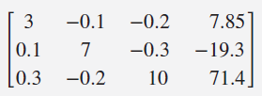
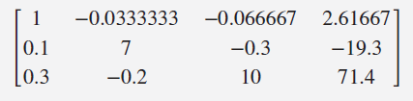
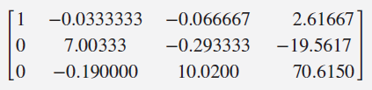
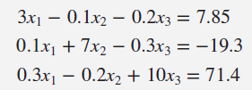
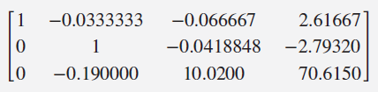



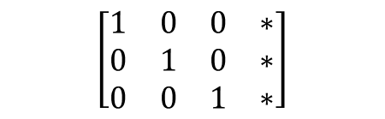
System of Linear Equations
Gauss-Jordan method
Normalizing
$$\left[\begin{matrix}1 & 0 & 0 & ∗ \\ 0 & 1 & 0 & ∗ \\ 0 & 0 & 1 & ∗\end{matrix}\right]$$
50% more than Gauss elimination
Number of flops
College of Engineering, Sungkyunkwan University

Slide 12
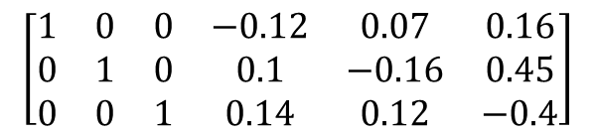
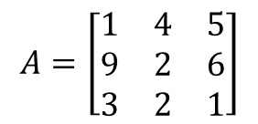
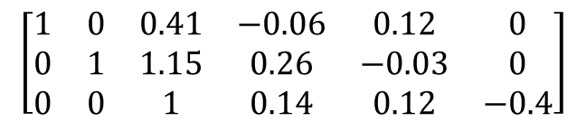
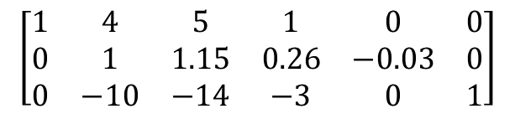
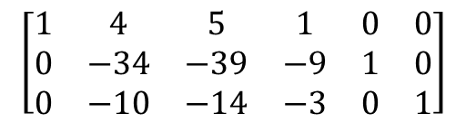
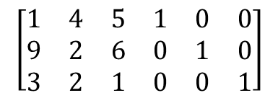
Inverse of Matrix Using Gauss-Jordan Method
Find the inverse of the matrix below using the Gauss-Jordan Method
$$A=\left[\begin{matrix}1 & 4 & 5 \\ 9 & 2 & 6 \\ 3 & 2 & 1\end{matrix}\right]$$
$$\left[\begin{matrix}1 & 4 & 5 & 1 & 0 & 0 \\ 9 & 2 & 6 & 0 & 1 & 0 \\ 3 & 2 & 1 & 0 & 0 & 1\end{matrix}\right]$$
$$\left[\begin{matrix}1 & 4 & 5 & 1 & 0 & 0 \\ 0 & −34 & −39 & −9 & 1 & 0 \\ 0 & −10 & −14 & −3 & 0 & 1\end{matrix}\right]$$
$$\left[\begin{matrix}1 & 4 & 5 & 1 & 0 & 0 \\ 0 & 1 & 1.15 & 0.26 & −0.03 & 0 \\ 0 & −10 & −14 & −3 & 0 & 1\end{matrix}\right]$$
Augmented matrix
$$\left[\begin{matrix}1 & 0 & 0.41 & −0.06 & 0.12 & 0 \\ 0 & 1 & 1.15 & 0.26 & −0.03 & 0 \\ 0 & 0 & 1 & 0.14 & 0.12 & −0.4\end{matrix}\right]$$
$$\left[\begin{matrix}1 & 0 & 0 & −0.12 & 0.07 & 0.16 \\ 0 & 1 & 0 & 0.1 & −0.16 & 0.45 \\ 0 & 0 & 1 & 0.14 & 0.12 & −0.4\end{matrix}\right]$$
College of Engineering, Sungkyunkwan University

Slide 13




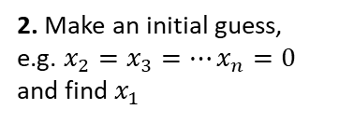
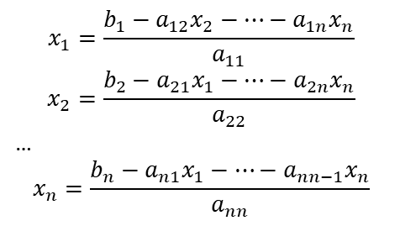
Gauss-Seidel Method
$$x_{1}=\frac{b_{1}−a_{12}x_{2}−…−a_{1n}x_{n}}{a_{11}}$$
$$x_{2}=\frac{b_{2}−a_{21}x_{1}−…−a_{2n}x_{n}}{a_{22}}$$
…
$$x_{n}=\frac{b_{n}−a_{n1}x_{1}−…−a_{nn−1}x_{n}}{a_{nn}}$$
1. Solve each equation for its unknown on the diagonal
2. Make an initial guess, e.g. $x_{2}=x_{3}=…x_{n}=0$ and find $x_{1}$
3. Find $x_{1}$ and find a new approximation for $x_{2}$ by substituting $x_{1}$ in the 2nd equation
4. Substitute $x_{1}$ and $x_{2}$ to make a new approximation for $x_{3}$
Diagonally dominant
Sufficient but not necessary condition of convergence
5. Continue similarly and get back to the first equation and repeat the procedure till the solution converges
College of Engineering, Sungkyunkwan University

Slide 14
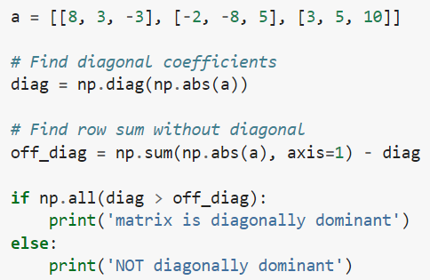
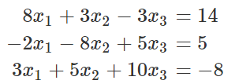
Gauss-Seidel Method
College of Engineering, Sungkyunkwan University

Slide 15
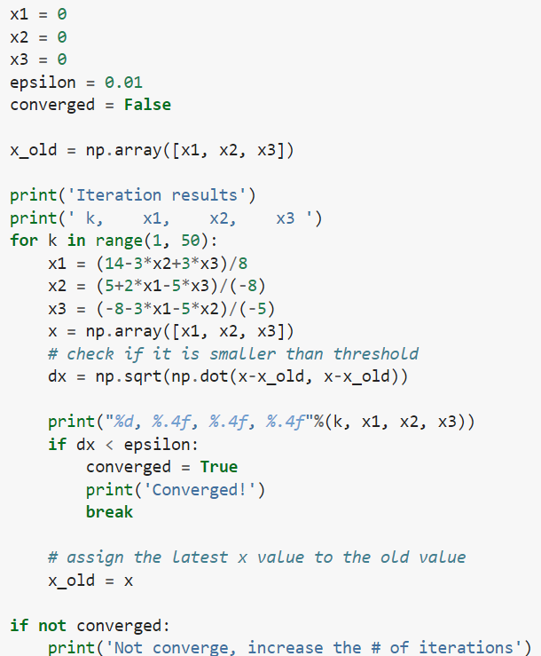
Gauss-Seidel Method
College of Engineering, Sungkyunkwan University

Slide 16
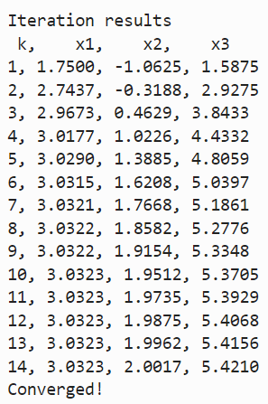
Gauss-Seidel Method
College of Engineering, Sungkyunkwan University

Slide 17
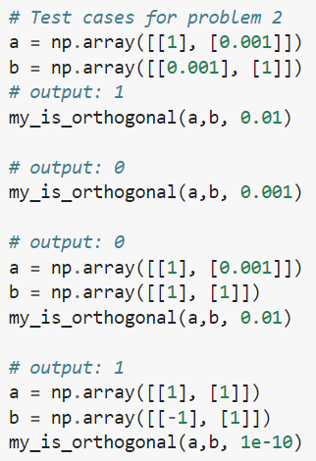
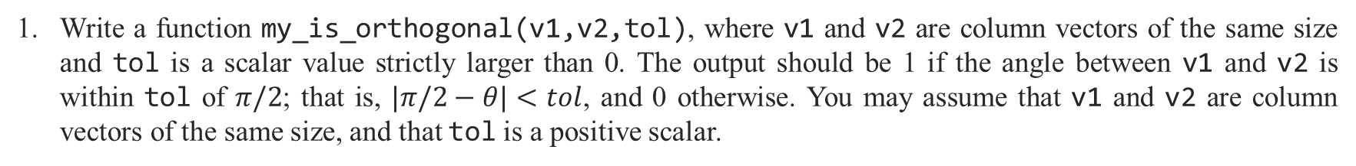
Assignment 7
Write a function my_is_orthogonal(v1,v2,tol), where v1 and v2 are column vectors of the same size and tol is a scalar value strictly larger than 0. The output should be 1 if the angle between v1 and v2 is within tol of $π/2$; that is, $|π/2−θ|<tol$, and 0 otherwise. You may assume that v1 and v2 are column vectors of the same size, and that tol is a positive scalar.
Test Case
College of Engineering, Sungkyunkwan University

Slide 18
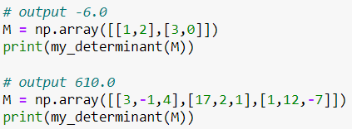
Assignment 7
Program a function my_determinant(M) which calculates the determinant of the matrix M using the Gauss Elimination algorithm.
Test Case
College of Engineering, Sungkyunkwan University

